Slide 1
ETL Manager
Working Prototype
  Real-time Job Status Monitor
  Historical Job Status details
  Execute job on-demand
Extra Features can be added
  User specific Job monitor ( User can add jobs in his/her monitor list)
  View details of the jobs configured
  Admin user can view the Server Health
  Admin User can add multiple Job Server configuration to ETL Manager

Slide 2
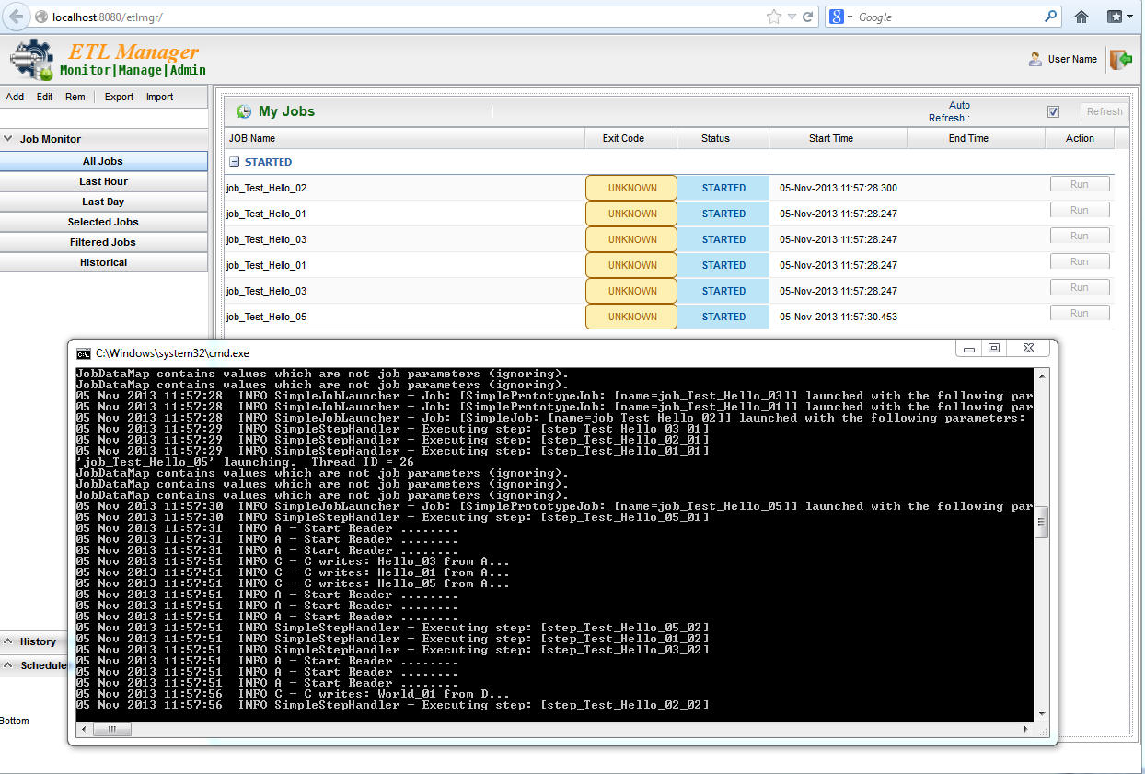
Real Time Job Status
Auto refresh by every 5 seconds
Manual refresh
All the running jobs
Jobs executed from last hour/day
Selected jobs by user (Select by job names)

Slide 3
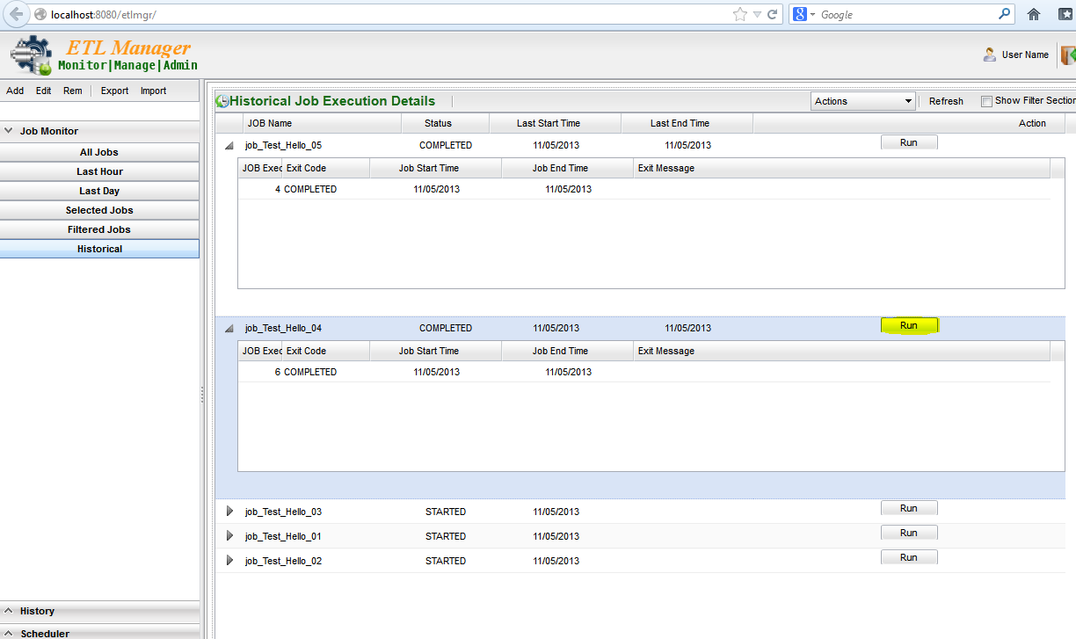
Historical Job Status
Get all the past execution details
Click on the “Run” button to execute the job.

Slide 4
Behind the Scene
Job Server
Read the JobDetails
for running the job
On-demand.
Also can be used for reading the
Current job status
J
M
X
At the server start-up the JMX
Exporter keeps all the
Required data ready
For ETL-Manager
To read
ETL Manager
GWT UI for
Achieving
Auto-refresh
Of status
Database
Stores all the
Job status
Trigger JOB
ETL User
Information
Database
Read job status from Database
to display status

Slide 5
Thank You !!!

